Slide 1

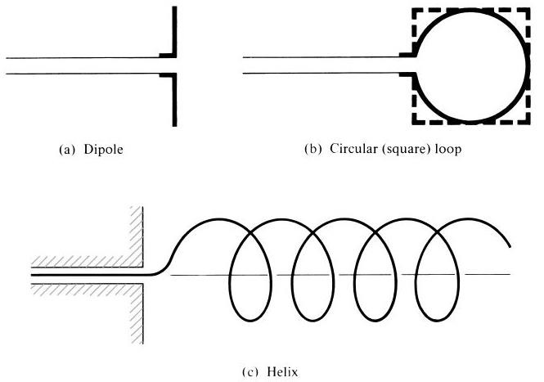
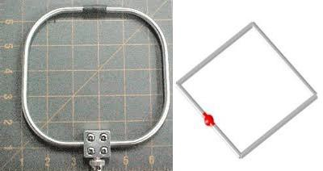
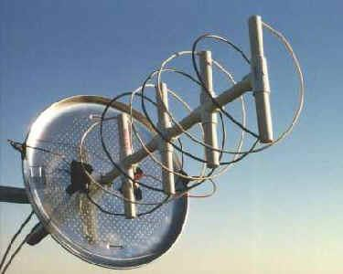

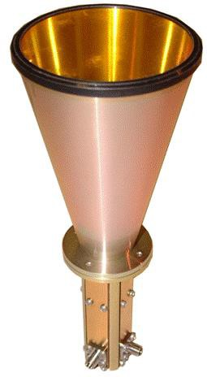
Dept. of Communication Engineering College of Engineering- University of Diyala Lecture No.: 3 part(1)
3rd year Class
Antenna Theory and Design Lec. Jinan N. Shehab
Note: -
The λ/2 antennas are called as Hertz antennas. They have spherical radiation pattern.
The λ/4 antennas are called as Marconi antennas. They have semi-spherical radiation pattern.
3- Types of Antennas: -
Let us take a quick look on various types of antenna and their general application
1-1 wire Antennas: -
they can be broadly classified as:-
1- straight wire (Dipole) 2- Loop
3- Helix.
Applications:- these antennas are generally used in the fields of:- Automobiles, Buildings, Ships, Aircraft and Space-Craft.
1-2 Aperture Antenna:-
1- Pyramidal 2- Conical 3- Rectangular
.

Slide 2
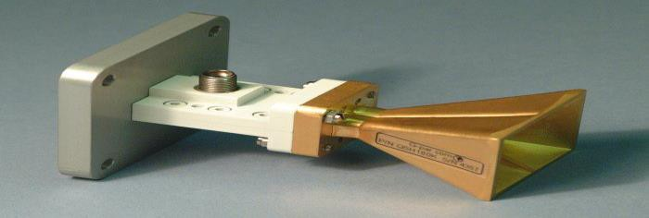
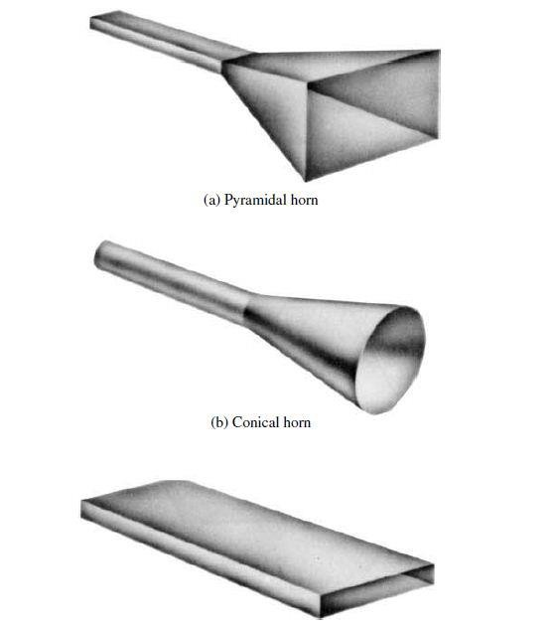
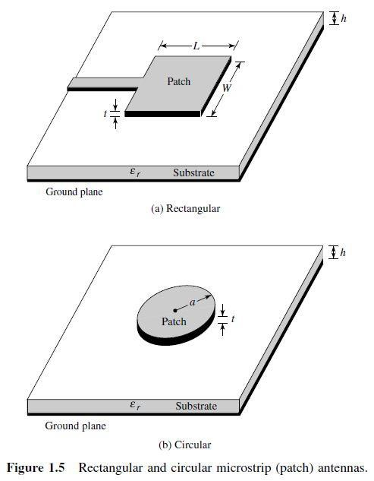
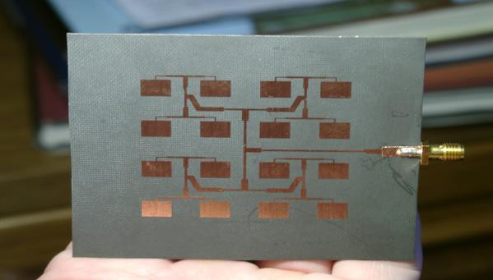
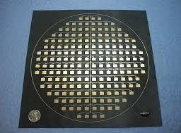
Dept. of Communication Engineering College of Engineering- University of Diyala Lecture No.: 3 part(1)
3rd year Class
Antenna Theory and Design Lec. Jinan N. Shehab
Application:- these antennas are generally used at the higher frequencies ( microwave ranges) in :- Aircraft, Spacecraft.
1-3 Microstrip Antennas:- these antennas consist of ametallic patch on a grounded substrate , and are commonly in the shapes such as:- Rectangular, Square, Circular.
Application:- they are specially designed for space borne applications and also used for government and commercial application.
1-4 Array Antennas:- the arrangments of the array are such that the radiation from the elements adds up to give a radiation maximum in a particular direction or directions and minmimum in others, or as desired.

Slide 3
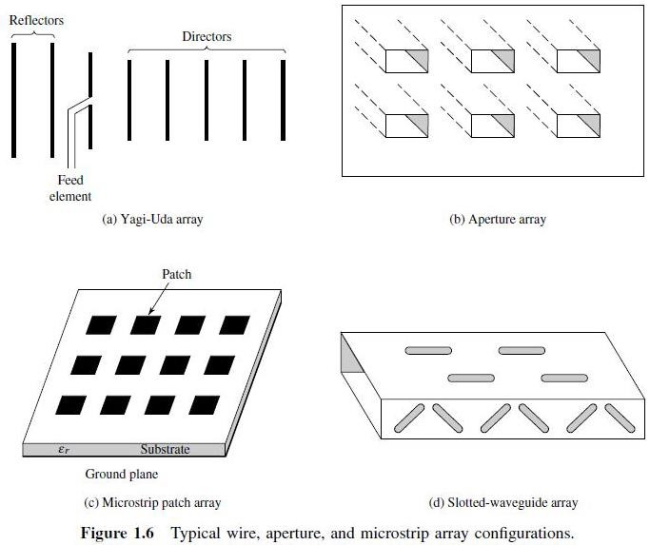
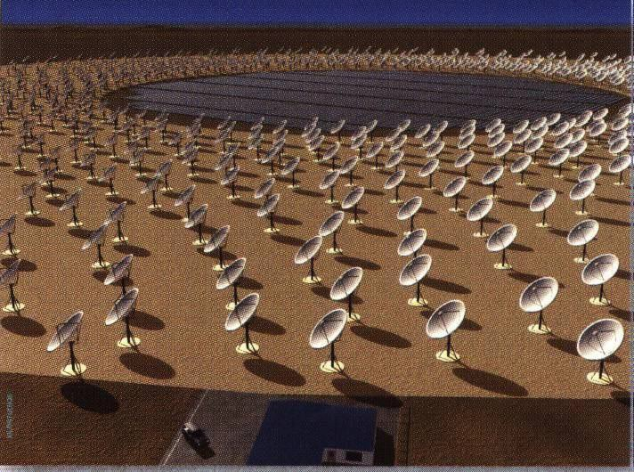
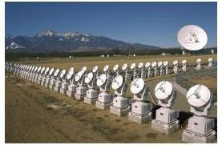
Dept. of Communication Engineering College of Engineering- University of Diyala Lecture No.: 3 part(1)
3rd year Class
Antenna Theory and Design Lec. Jinan N. Shehab
1-5 Reflector Antennas :-these antennas are built with diameters as large as 305 m.
Such large dimensions are needed to achieve the high gain reuired to transmit or receive signals after millions of miles of travel.

Slide 4
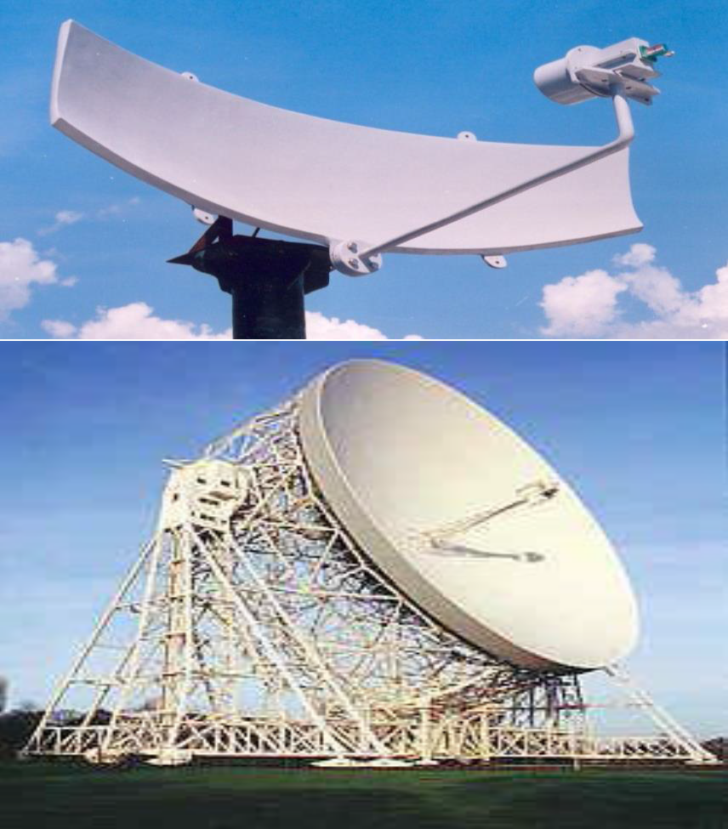
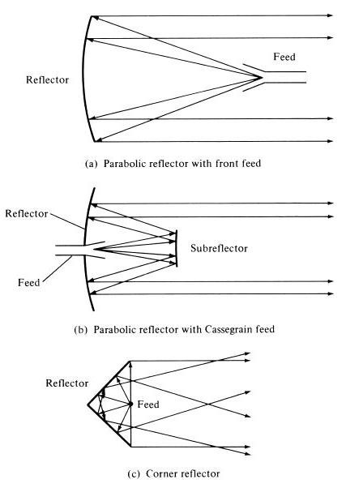
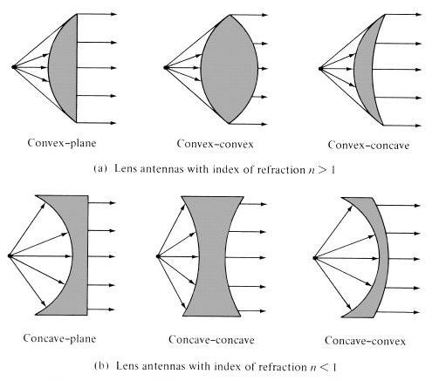
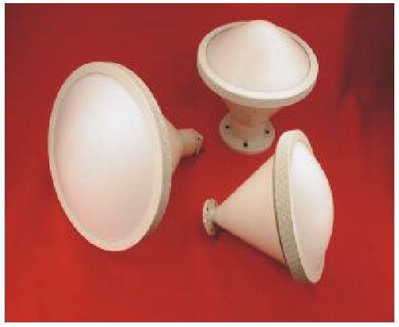
Dept. of Communication Engineering College of Engineering- University of Diyala Lecture No.: 3 part(1)
3rd year Class
Antenna Theory and Design Lec. Jinan N. Shehab
1-6 Lens Antennas:- collimate incident divergence energy to prevent it from spreading in undesired direction.
2- Fundamental Parameters of Antennas
To describe the performance of an antenna, definitions of various parameters are necessary.

Slide 5
Dept. of Communication Engineering College of Engineering- University of Diyala Lecture No.: 3 part(1)
3rd year Class
Antenna Theory and Design Lec. Jinan N. Shehab
Some of the parameters are interrelated (one dependent of on other parameters), These characteristics include: (a) antenna pattern (b) radiation intensity (c) directive gain & (d) power gain.
  Antenna Patterns (Radiation Patterns):-
An antenna radiation pattern or antenna pattern is defined as “a mathematical function
or a graphical representation of the radiation properties of the antenna as a function of space coordinates". In most cases the radiation pattern is determined in the far field regin and is represented as function of the directional coordinates, in a polar parameters (r,ɸ, θ) antenna pattern may sub classified into:-
    Field Pattern (in linear scale): – typically represents a plot of the magnitude of the electric or magnetic field as a function of the angular space (r,θ) and (r,ɸ).
    Power pattern (in linear scalr):-typically represents a plot of the square of the magnitude of the electric or magnetic field as a function of the angular space (r,θ) and
(r,ɸ).
    Power pattern (in dB):-represents the magnitude of the electric or magnetic field in decibels as a function of the angular space.
Where
r:- represent the magnitude of the power in P-pattern or the value of the electrical or magnetic in field pattern.
Θ= Elevation angle= electric field. ɸ= Azimuth angle= magnetic field.
Defined for the far-field.
As a function of directional coordinates.
Often normalized with respect to their maximumvalue.
𝐸_{𝜃}(𝜃. ∅)
����𝑎�𝑖𝑧�� �𝑖��� �𝑎����� = 𝐸_{𝜃�}(𝜃, ∅)� = _{𝐸(𝜃. ∅)}
(�𝑖����𝑖������) (1)
𝜃
��𝑥
𝑆_{𝜃}(𝜃. ∅)
����𝑎�𝑖𝑧�� ����� �𝑎����� = �_{𝜃�}(𝜃, ∅)� = _{𝑆(𝜃. ∅)}
(�𝑖����𝑖������) (2)
Where:-
𝜃
��𝑥
2 2
_{𝑊�}−2
S(θ,ɸ)= poynting vector =
[𝐸_{𝜃}(𝜃.∅)+𝐸∅ (𝜃.∅)]
�₀
𝑆(𝜃. ∅)_{��𝑥}= �𝑎�𝑖��� �𝑎��� ���(𝜃. ɸ). 𝑊�⁻²
Z0= intrinsic impedance of space=376.7Ω.

Slide 6
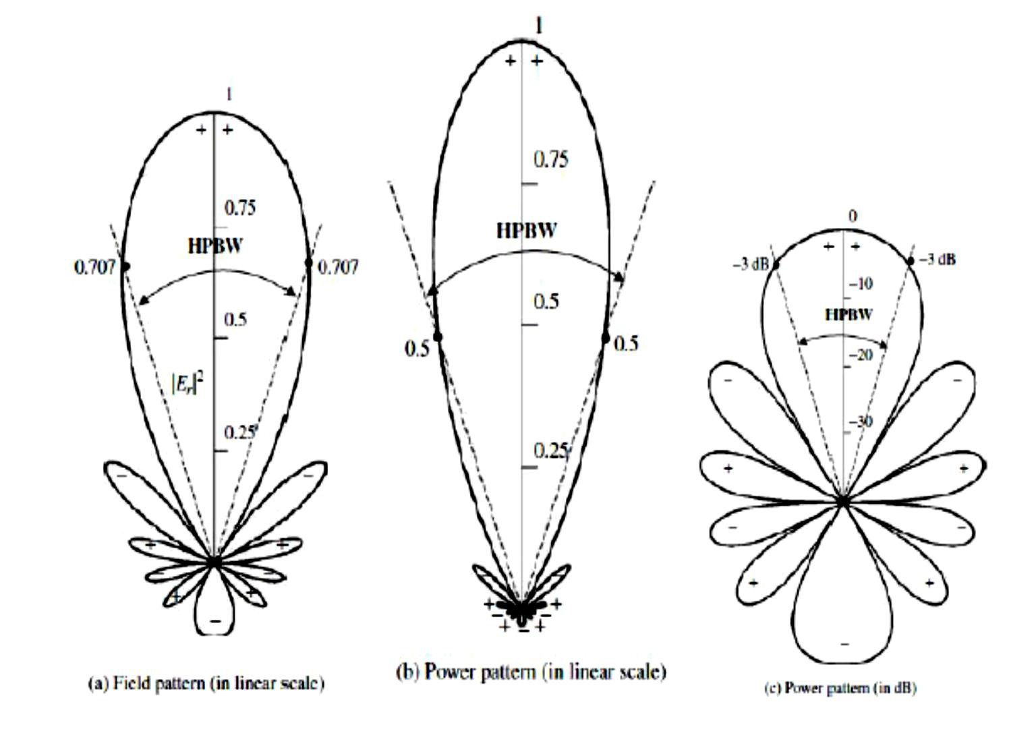
Dept. of Communication Engineering College of Engineering- University of Diyala Lecture No.: 3 part(1)
3rd year Class
Antenna Theory and Design Lec. Jinan N. Shehab
Example:- plot the field and power pattern for hertzian dipole if
𝑭_{��𝒓���𝒍�} = {�_{𝟎}�𝑰_{𝟎}�𝒍��^{−�𝜷𝒓}𝐬𝐢𝐧(𝜽)}/𝟒𝝅�.
Solution:-
To simplify the plot of the pattern:-
Find the symmetry of the F(θ)=E about the axis.
Find the maximum and minimum values of F(θ) by equating F(θ) to zero (d F(θ)/dθ
=0) and solve for θ.
Find the nulls of F(θ) equating F(θ) to zero (F(θ)=0) and solve for θ
Plot r vrsus θ or ɸ only for nonmetric region and rotate the plot about the axis to obtain the image of plot about the symmetric axis.

Slide 7
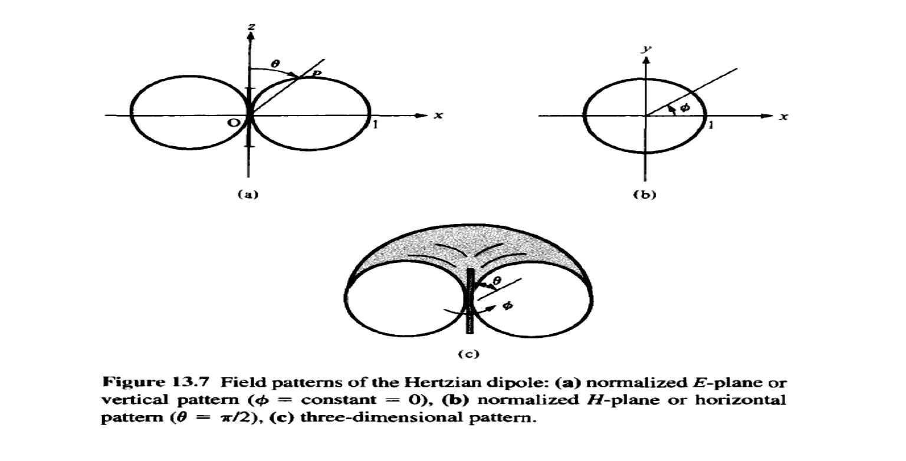
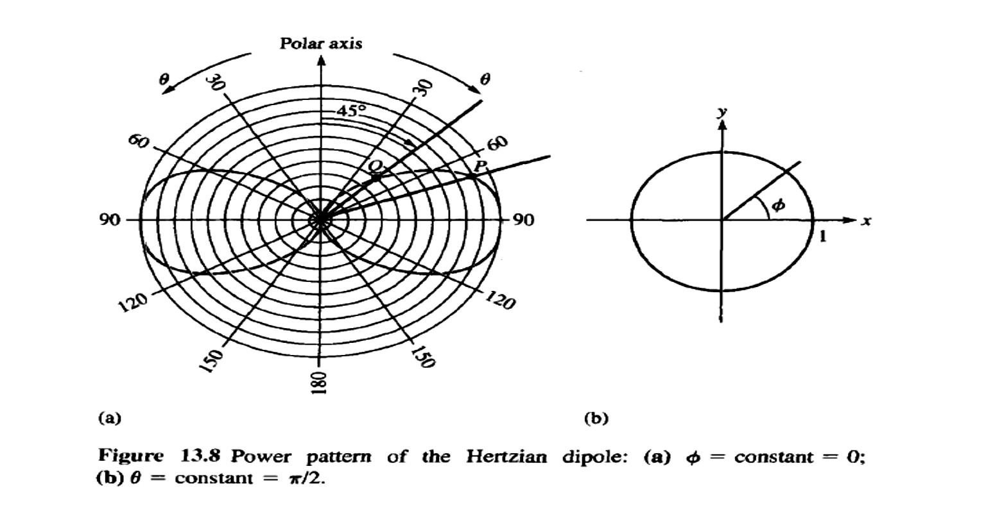
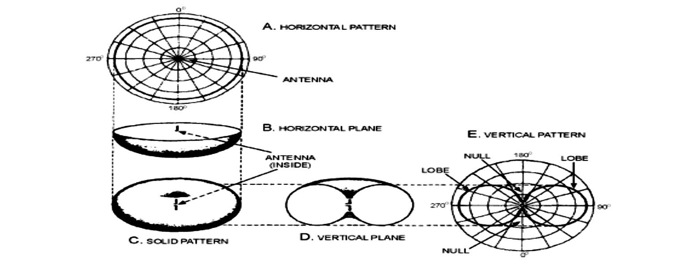
Dept. of Communication Engineering College of Engineering- University of Diyala Lecture No.: 3 part(1)
3rd year Class
Antenna Theory and Design Lec. Jinan N. Shehab

